Slide 1

Design a differential amplifier operating on a lower supply voltage of
1.8 V, utilizing a wide-swing (high-compliance) cascode current mirror
load. Analyze the trade-offs made to maximize the output voltage swing
while maintaining a minimum voltage gain of 40 dB
ANALOG IC Design-Mini Project
MANISH

Slide 2
OBJECTIVES
Primary Objectives
Technical Motivation
  Design a differential amplifier operating on a lower supply voltage of 1.8 V.
  With a wide-swing cascode current mirror as load.
  Maintaining a minimum voltage gain of 40 dB.
  Analyzing the trade-of made to maximize the output voltage swing.
  Maintaining all Transistor in saturation mode.
  Standard cascode mirrors consume high voltage headroom (Vth+2Vov), limiting overall dynamic range.
  Wide-swing cascode biasing lowers required minimum voltage headroom to just 2Vov.
  Maintaining the output current of 10µA.

Slide 3
FEATURES
  High DC Voltage Gain
Achieves high single-stage gain by utilizing cascode output impedance boosting without needing extra amplifier stages.
  Wide Output Swing
Wide-swing active load enables maximum output dynamic range, bounded by minimum compliance headroom of above ground.
  Noise & CMRR
PMOS differential input pair provides low noise and high Common-Mode Rejection Ratio (CMRR) against supply fluctuations.

Slide 4
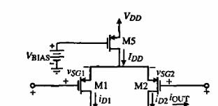
SCHEMATIC
Vin1
Vin2

Slide 5
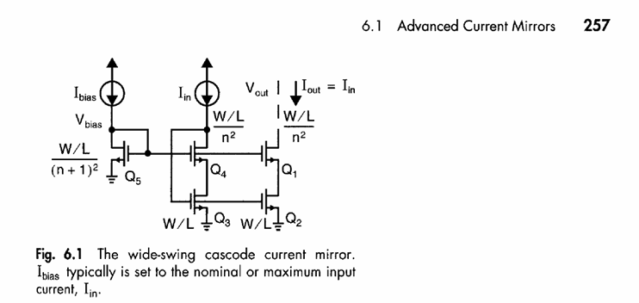
SCHEMATIC

Slide 6

DESIGN
S
Vb
G
M1
D
S
S
Vin1
M2
G
G
M3
Vin2
D
D
Ibias
Iref
Iout
Vout
D
D
D
M8
G
G
M4
G
M5
S
S
S
D
D
G
M6
G
M7
S
S

Slide 7
WORKING
  Differential Current Steering:
When the input voltage on one branch rises relative to the other, the circuit doesn't create new current it simply balance the current into one branch and away from the other. So like if left PMOS gets more current ( I_tail / 2 + Δ i), the right PMOS automatically gets less ( I_tail / 2 - Δi) .
  Active Load Current Mirroring:
The right output node has two opposing forces:
The top PMOS branch trying to push its current ( i_d2 ) into the output.
The bottom NMOS load pulling the mirrored current ( i_d1 ) down to ground.
Because the two currents move in opposite directions ( +Δ i vs -Δi ), they push and pull against the node's high output resistance, converting current difference into a huge single-ended voltage swing
  Cascode Impedance Shielding:
A cascode transistor is stacked directly on top of the bottom mirror transistor. It acts as an impedance multiplier and voltage buffer. It isolates the bottom transistor's drain, holding that node virtually constant regardless of how wildly Vout fluctuates.Because the bottom transistor sees a stable voltage, its current is constant.
  Headroom Preservation:
Wide-swing gate bias holds the bottom mirror drain-source voltage at exactly , preventing premature saturation loss. and makes Vds= Vov.

Slide 8
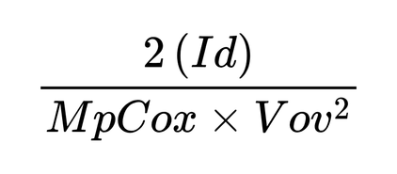
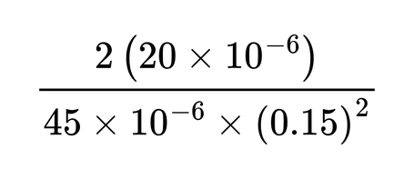




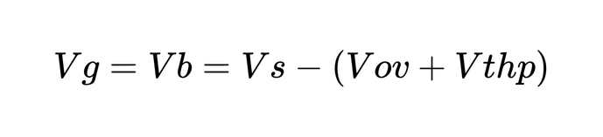
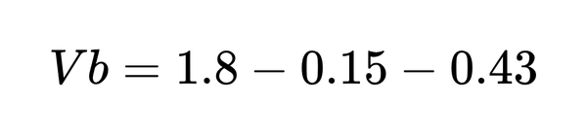

DESIGN
Assumed Vov=0.15V, MnCox = 165µ A/V², Vthn = 0.53V, Vthp = 0.43V, MpCox = 45µ A/V²
Iss=20µA and VDD = 1.8V
From the top Transistor M1 , the (W/L)1 is ,
Vb is ,

Slide 9
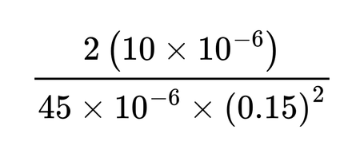

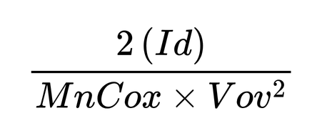
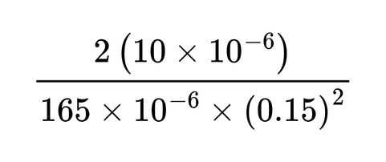

For the differential Pair Transistor M2 & M3 , the (W/L)2-3 is ,
For the main current mirror M4 & M5 , and the cascade mirror M6 & M7 the (W/L) is ,
n = 1

Slide 10
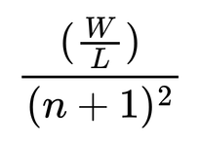
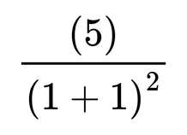

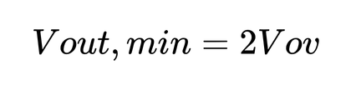
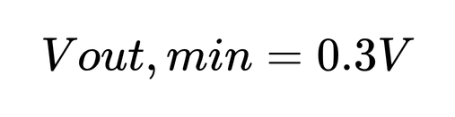

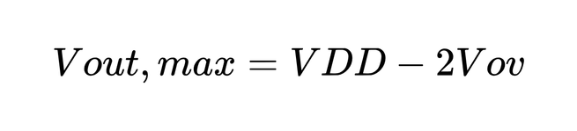

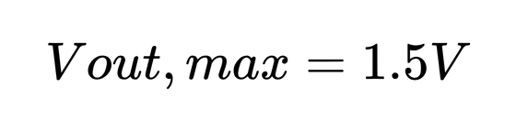
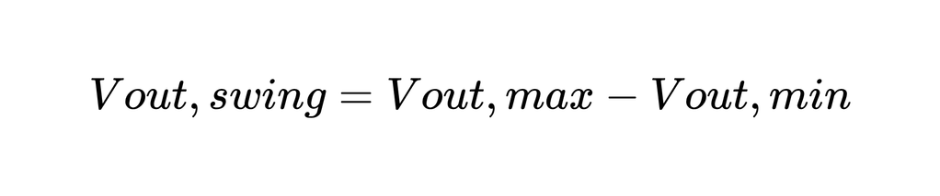
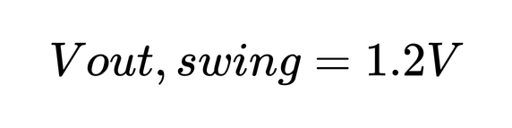
For the Diode connected Transistor M8 , the (W/L)8 is ,
For the Output Voltage ,

Slide 11
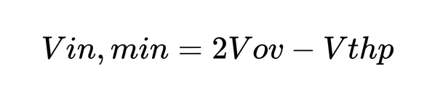

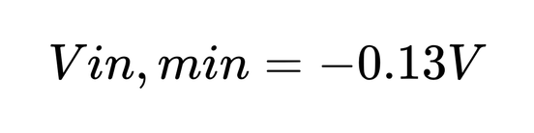
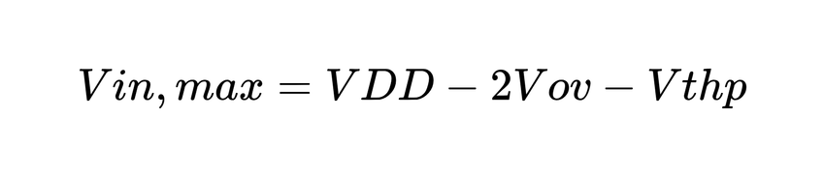
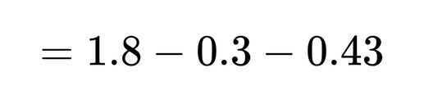
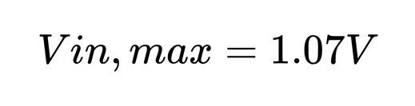
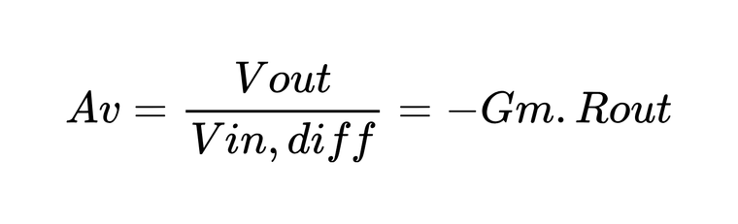
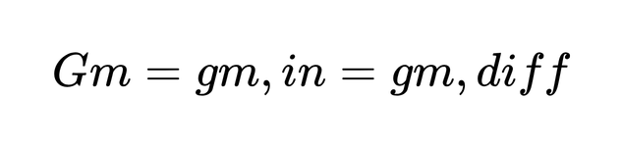

For the Input Voltage Vin,
For the Voltage gain ,
( Transconductance of input diff. pair transistor )

Slide 12
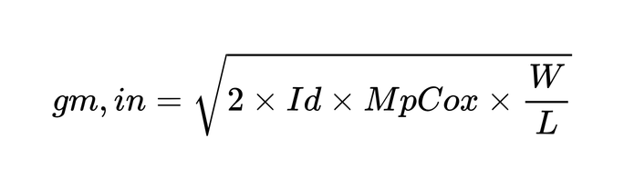
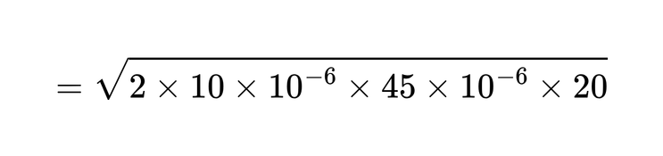
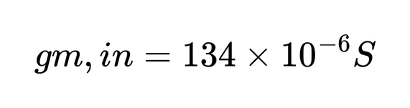
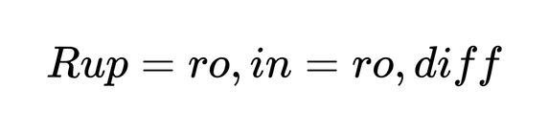
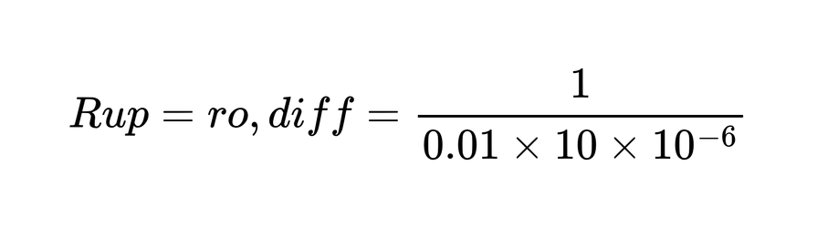

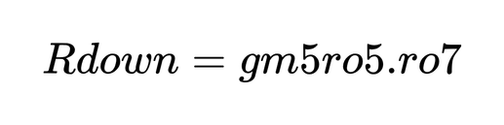
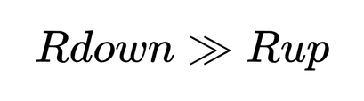
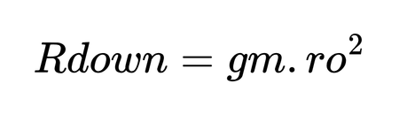
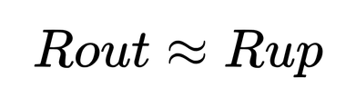
( Assumed channel length modulation is equal to 0.01 )
( Because Rup dominates Rout )

Slide 13
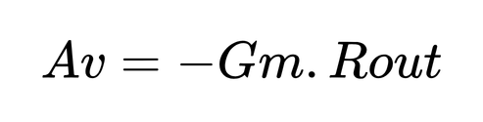
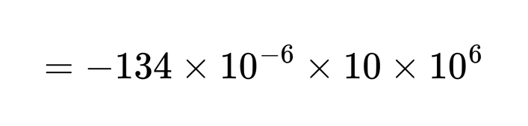
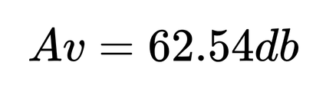
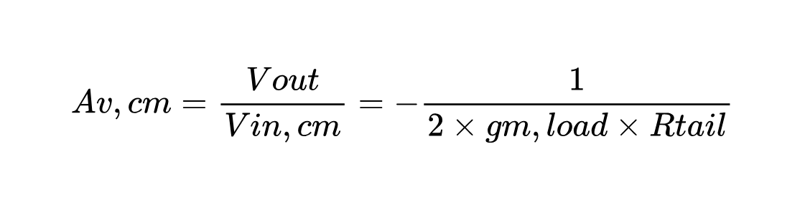
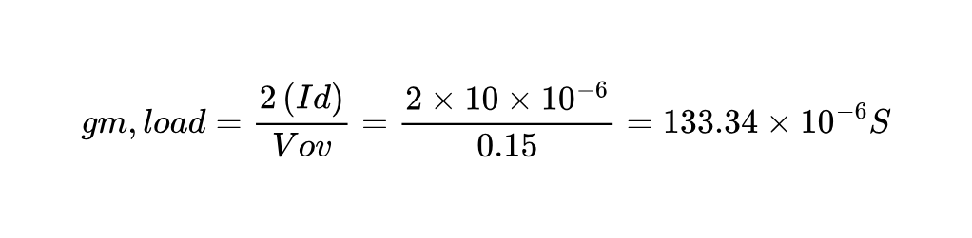
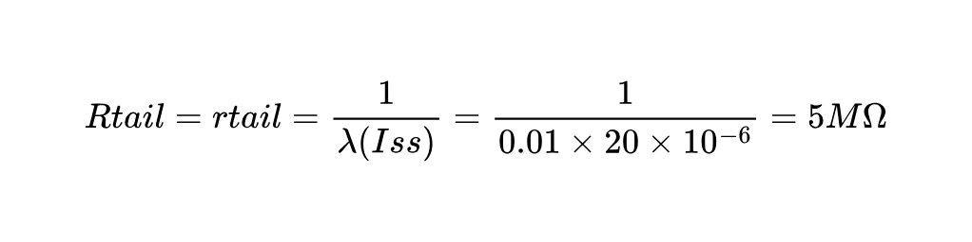
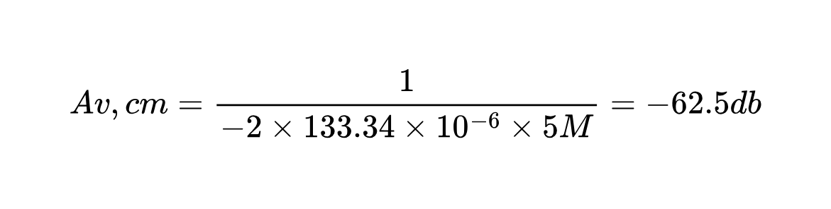
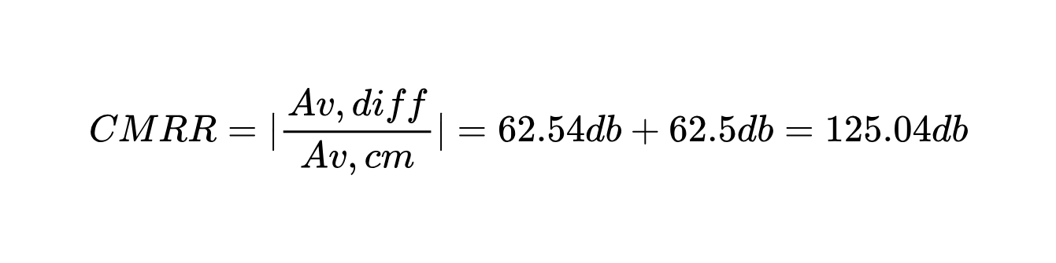

Slide 14
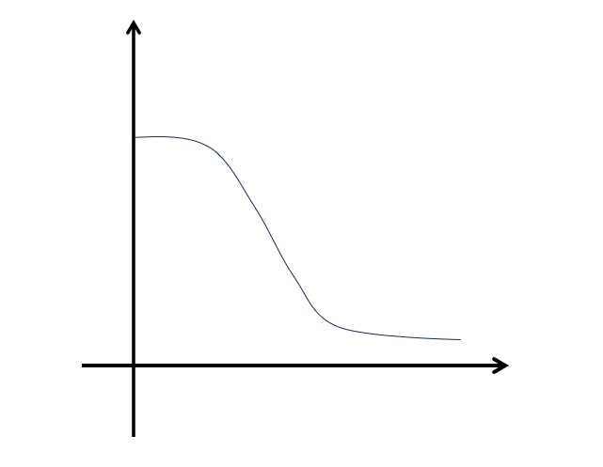
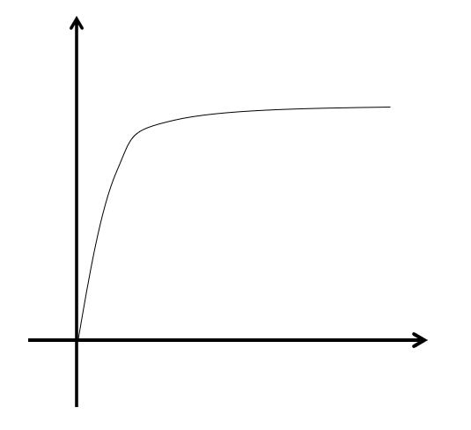
EXPECTED WAVEFORM
Vout
Iout
DC Transfer Characteristic
2Vov
Vdd - 2Vov
Output Characteristic
2Vov
Vin
Vout

Slide 15
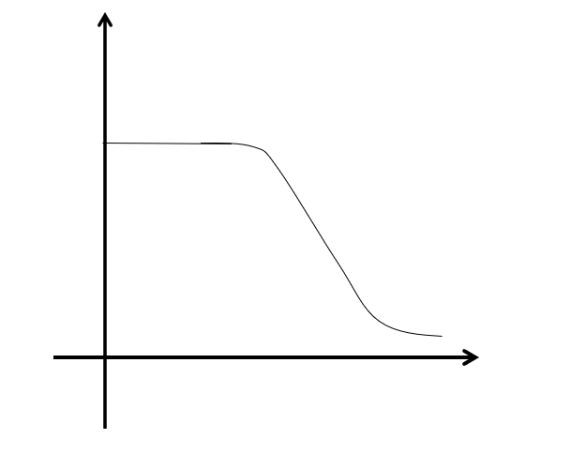
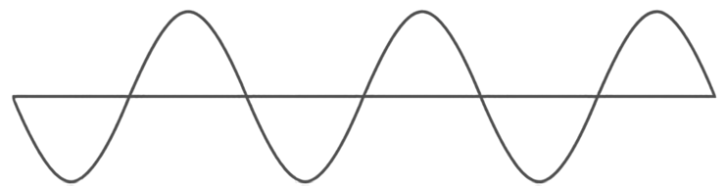
EXPECTED WAVEFORM
Gain in db
Transient Graph
Gain Graph
62.54db
Vout,max
Vout,min
Frequency

Slide 16

Performance
62.54db
1.2V
125.04db
54µW
DC Voltage Gain
Output Swing (p-p)
CMRR performance
Power Dissipation

Slide 17
RESOURCES/REFERENCES USED
  Behzad Razavi , Design Of Analog CMOS Integrated Circuits, Second Edition.
  Analog Integrated Circuit Design , David Johns , Ken Martin, University of Toronto.
  Phillip E. Allen Douglas R. Holberg crvlos Analog Circuit Design Second Edition
  P. R. Gray, P. J. Hurst, S. H. Lewis, R. G. Meyer, Analysis and Design of Analog Integrated Circuits, Fifth Edition.

Slide 18
Thank You!
Analog IC Design Mini-Project Presentation

